Slide 1


Facebook Marketplace Dataset
https://colab.research.google.com/drive/1qfpZfl6wO5K2HYC63jqvQYDkhBT4VcKk?usp=sharing Link to the google collab notebook

Slide 2

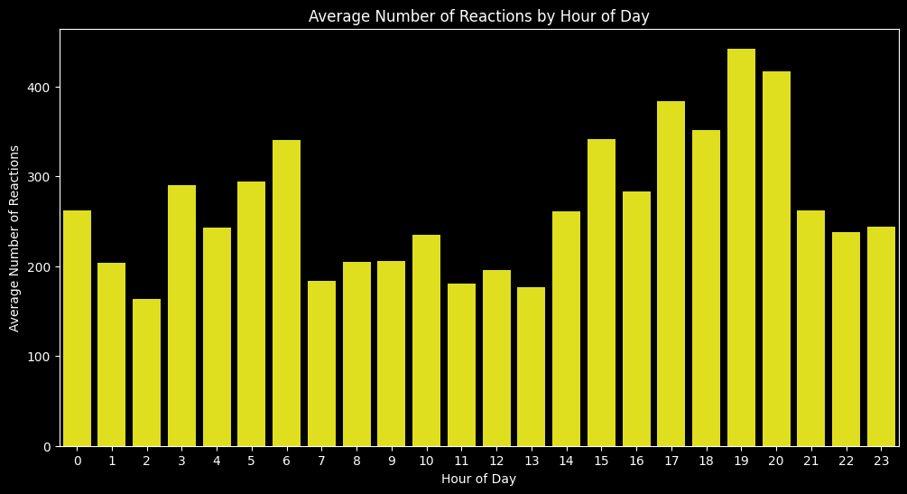
How does the time of upload affect the number of reactions?
From the graph we can see that people are most active in the night around 7 pm to 8pm and at the time the number of reaction is higher
Therefore the optimal time to upload content to get more number of reactions is around 7pm to 8pm

Slide 3
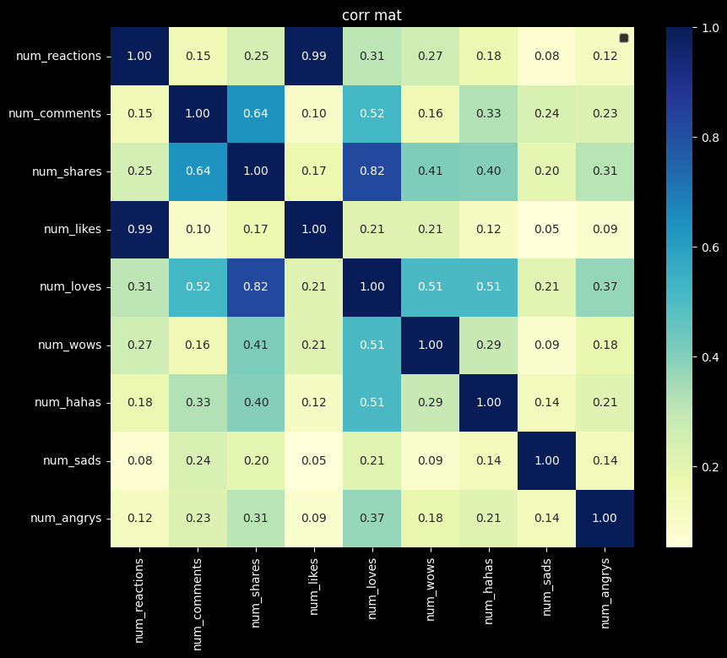
Is there a correlation between the number of reactions and other engagement metrics such as comments and shares If so, what is the strength and direction of this correlation?
From the graph we can see that there is a correlation of 0.82 between shares and loves , so this shows that the more loved content gets the shared the more(This is a strong correlation)
There is also a correlation of 0.64 between comments and shares (This is a moderate correlation)

Slide 4
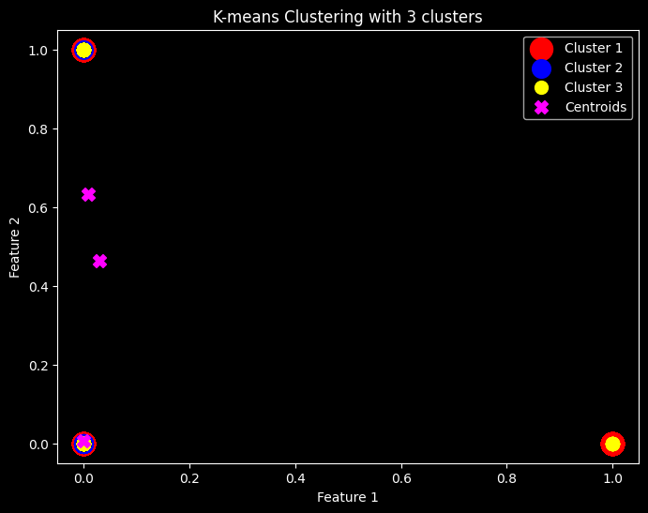
Use the columns status_type, num_reactions, num_comments, num_shares, num_likes, num_loves, num_wows, num_hahas, num_sads, and num_angrys to train a K-Means clustering model on the Facebook Live Sellers dataset

Slide 5
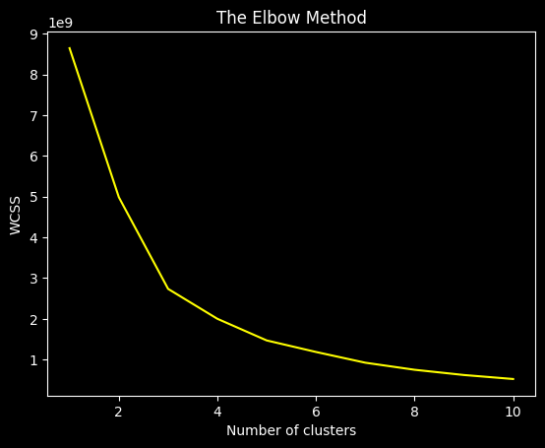
Use the elbow method to find the optimum number of clusters.
Since there is a significant bend in the line on 3 , we can take 3 as total number of clusters

Slide 6
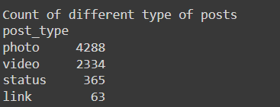
What is the count of different types of posts in the dataset?
There are 4288 photo type posts , 2334 video type posts , 365 status type post and 63 link type post

Slide 7
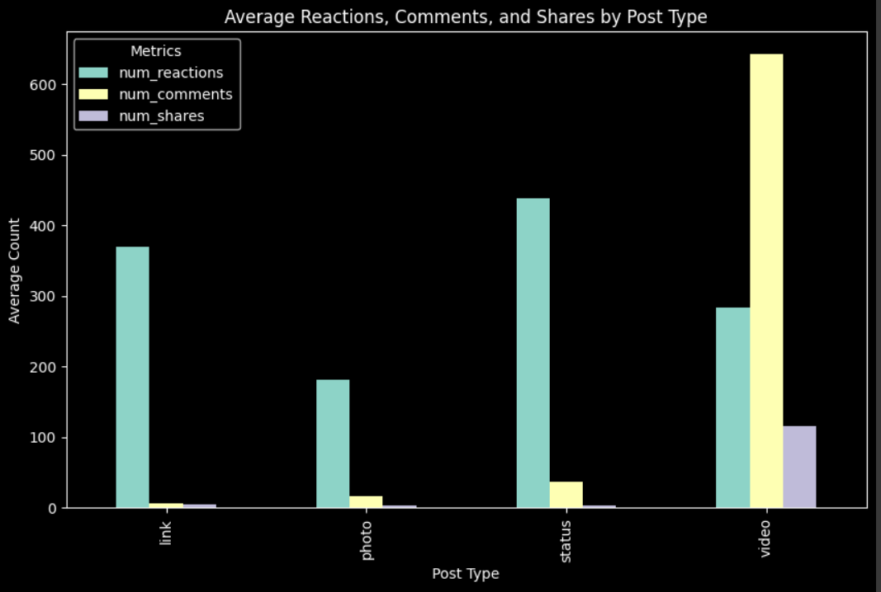
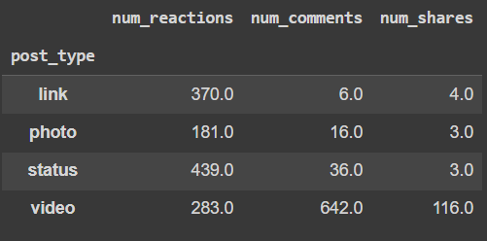
What is the average value of num_reaction, num_comments, num_shares for each post type?
From this we can infer that video type posts get the highest number of reactions , comments and shares

